Slide 1
1.1 Installation of Redhat Linux

Slide 2
Installation methods
Red Hat provides several installation media that you can download from the Customer Portal website using your active subscription.
  A binary DVD containing Anaconda, the Red Hat Enterprise Linux installation program, and the BaseOS and AppStream package repositories. These repositories contain the packages needed to complete the installation without additional material.
  A boot ISO containing Anaconda, but requires a configured network to access package repositories made available using HTTP, FTP, or NFS.
  A QCOW2 image containing a prebuilt system disk ready to deploy as a virtual machine in cloud or enterprise virtual environments. QCOW2 (QEMU Copy On Write) is the standard image format used by Red Hat.

Slide 3
Setup Requirement
RHEL 8 can be installed on physical hardware and on virtual hardware. For the availability of specific features, it does not really matter which type of hardware is used, as long as the following conditions are met
  1GIB RAM
  10GIB hard disk
  A network card

Slide 4
The preceding requirements allow you to run a minimal installation of RHEL, but if you want to create an environment that enables you to perform all exercises described in this book, make sure to meet the following minimal requirements:

Slide 5
Setup input requirements
CPU: 1 socket, 2 cores
RAM: 2GB
Disk size:20GB
Hostname: workstation
IP: 192.168.0.128
Netmask:255.255.255.0
Redhat 8.4 DVD iso

Slide 6
Install Hypervisor
Two options
  Vmware workstation or
  Virtual box
For this LAB we choose vmware workstation 16
  Open vmware workstation

Slide 7
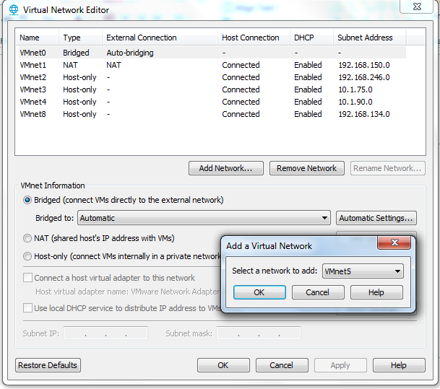
Setup virtual network
Click Edit->Virtual Network Editor
Click Add Network
Select network to add
  Vmnet5 or other free
  Click OK

Slide 8
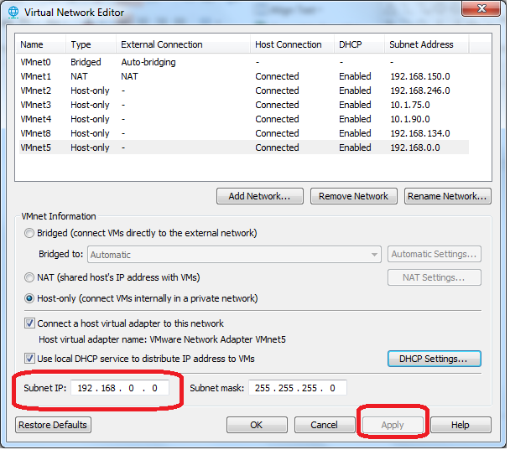
Change subnet to 192.168.0.0
and click apply
And click oK

Slide 9
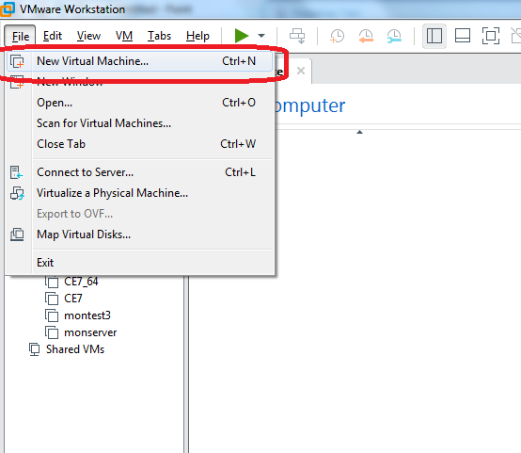
Create New virtual Machine

Slide 10
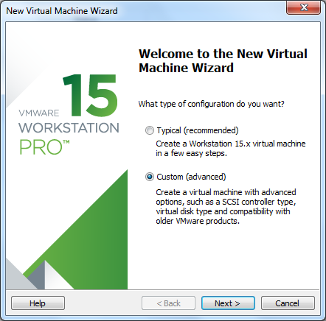
Select custom

Slide 11
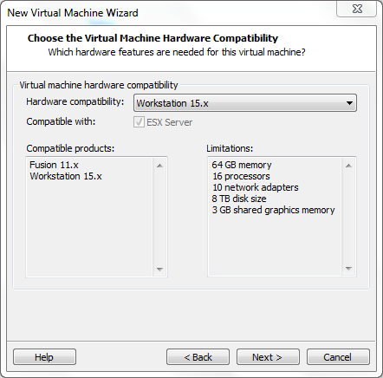
Select next

Slide 12
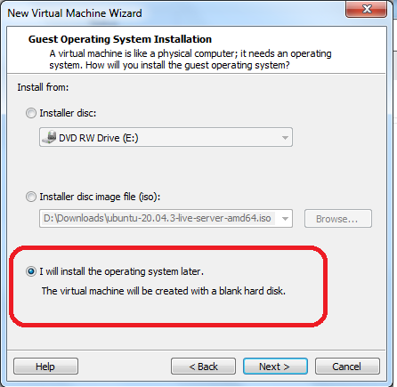
Select I will install later
And click next

Slide 13
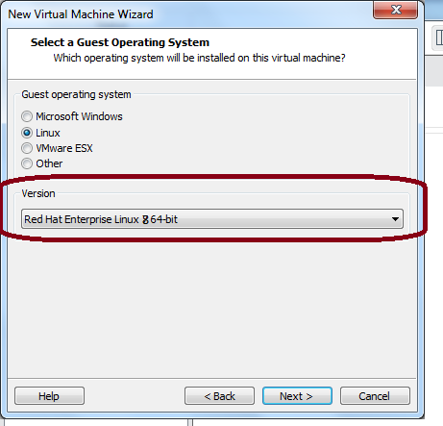
Select linux version

Slide 14
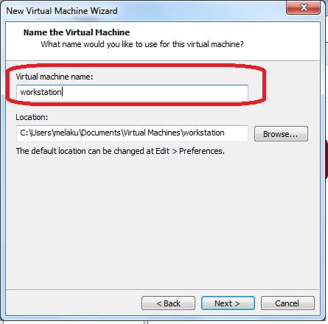
Give virtual machine name
  wrkstation

Slide 15
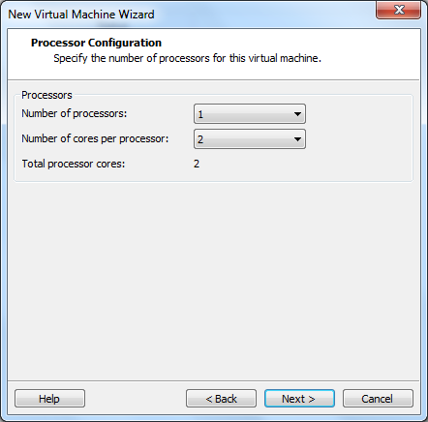
Give
Number of processor:- 1
Number f core per processor:- 2

Slide 16
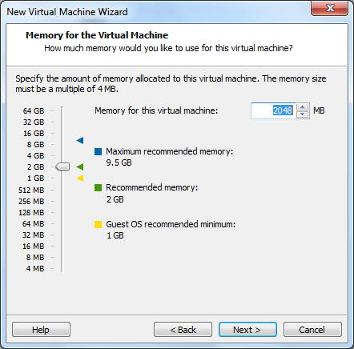
RAM: 2GIB (2048MB)

Slide 17
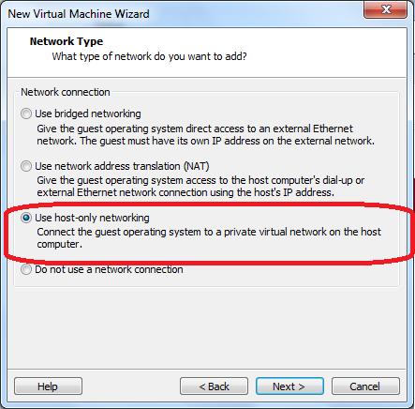
Select
  Use host-only networking

Slide 18
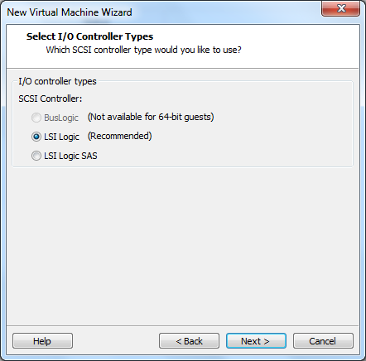

Slide 19
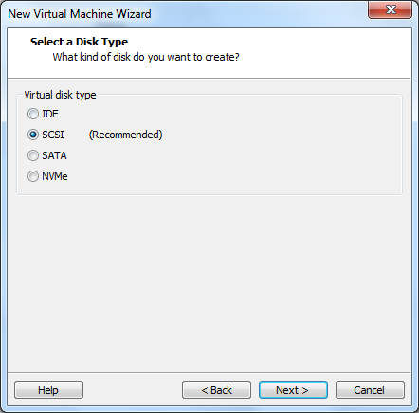

Slide 20
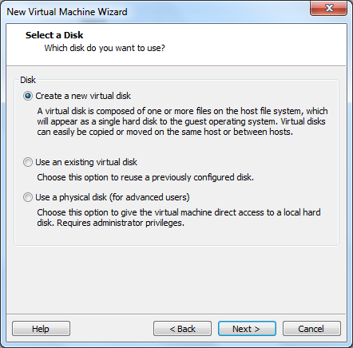

Slide 21
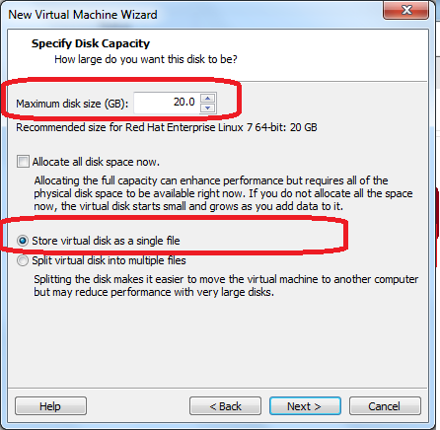

Slide 22
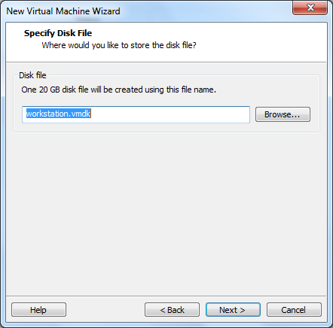

Slide 23
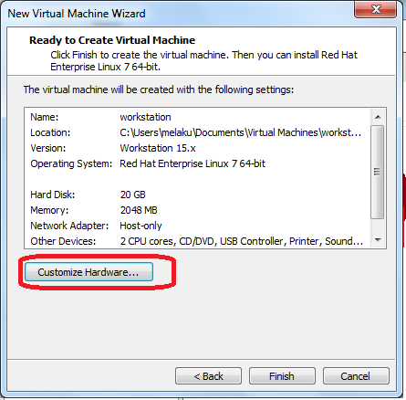
Click customized

Slide 24
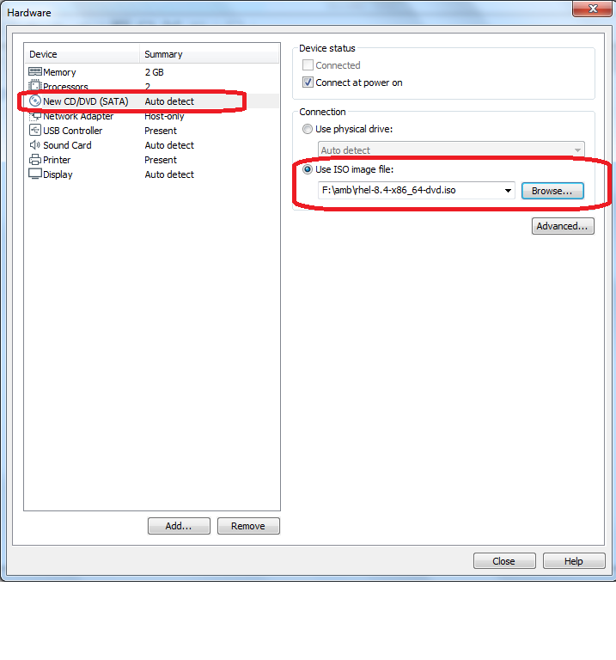
Click New CD/DVD
Use ISO image
  Browse the RHEL 8.4 iso image
Click close
Click ok

Slide 25
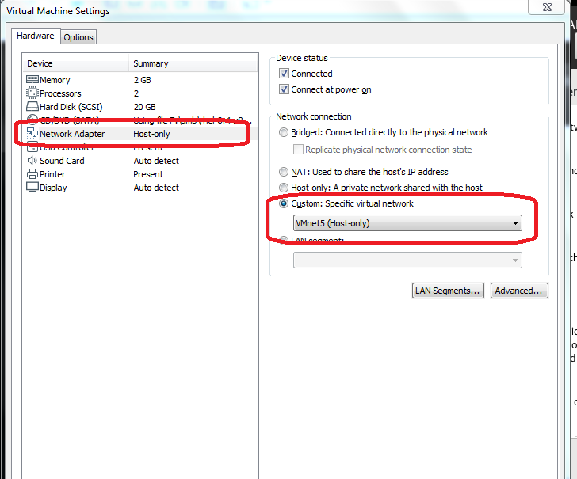
Custom Specific Network
  Vmnet5 (you configured in Earlier step)
Click OK

Slide 26
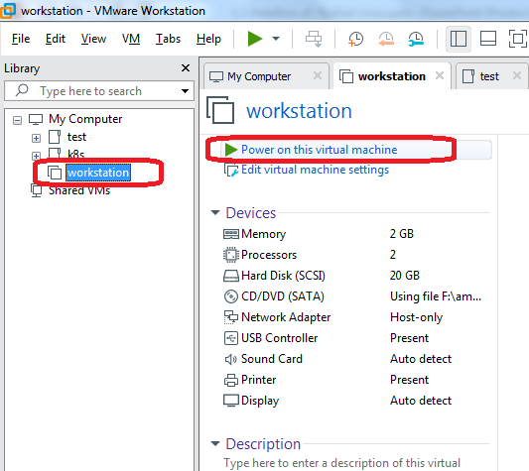
poweron

Slide 27
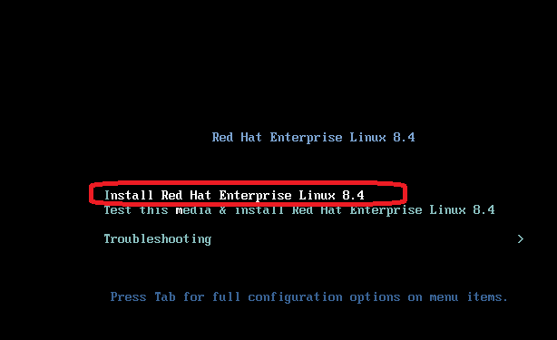
Select Install Redhat Enterprise
  Use up/down arrows
  Press enter

Slide 28
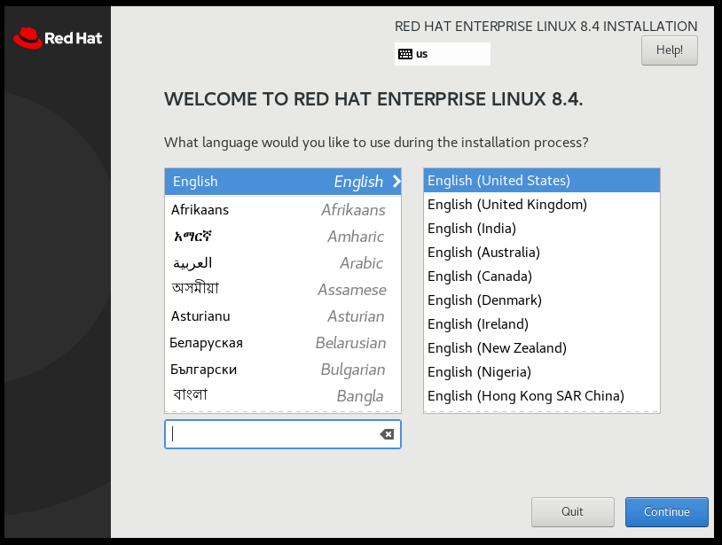
Language
  Select English (united states)
Click continue

Slide 29
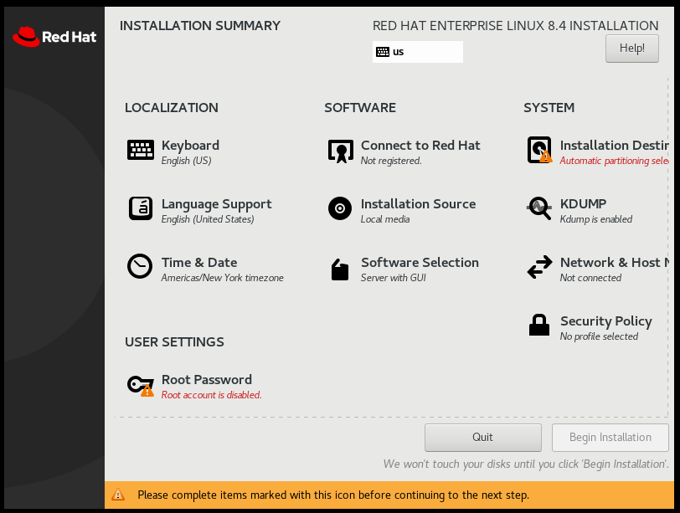
Click Time & date

Slide 30
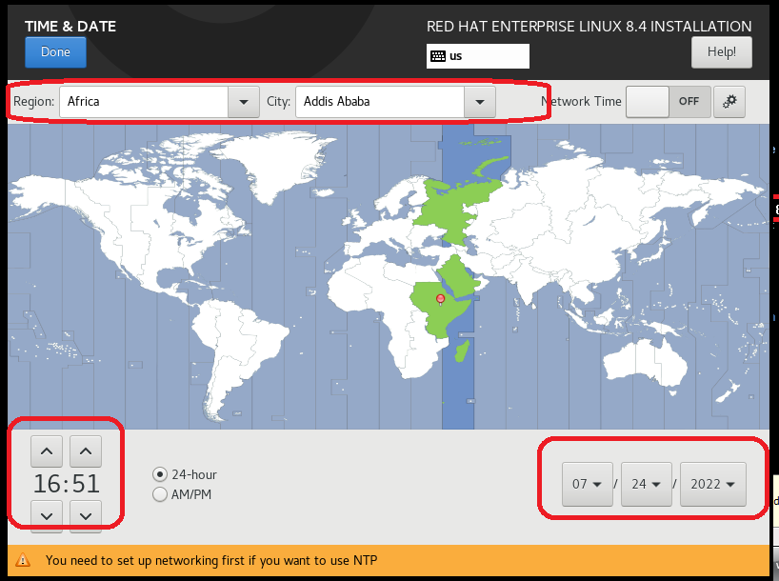
Select timezone
Set date
Set time
Click done

Slide 31
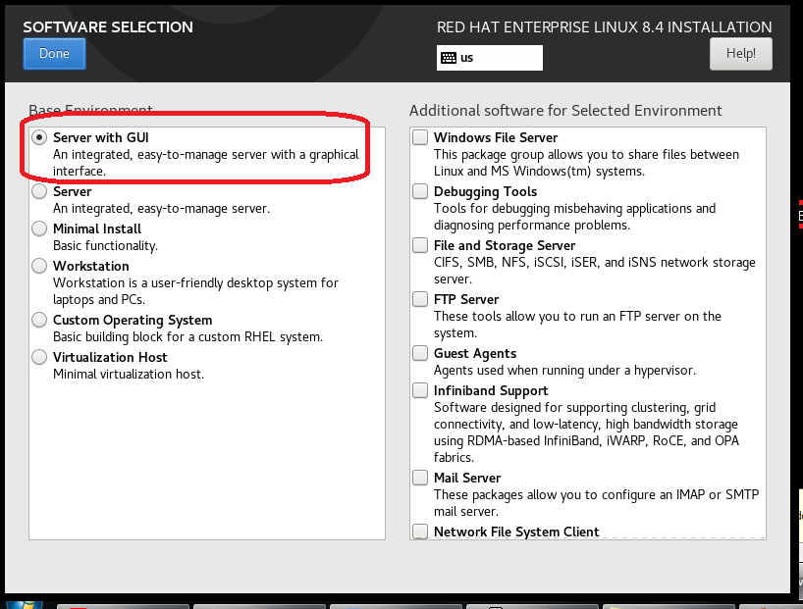
Select
  Server with GUI
Click Done

Slide 32
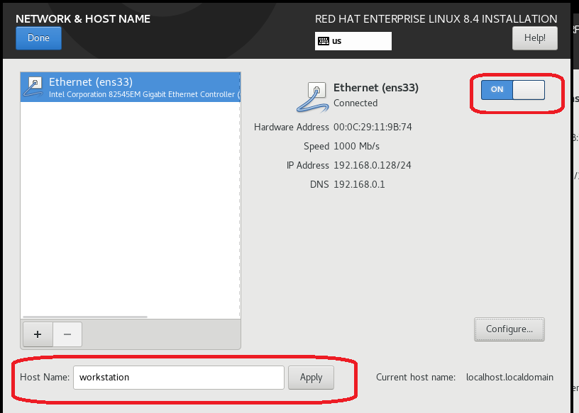
Network and hostname
  Click ON Ethernet
  Set hostname with “workstation” and click apply
Click done

Slide 33
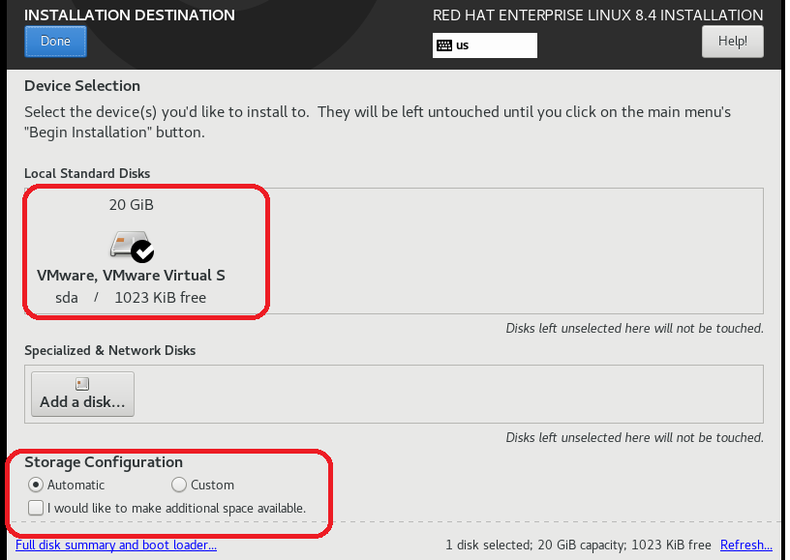
Set Storage configuration
  Automatic configuration
Click done

Slide 34
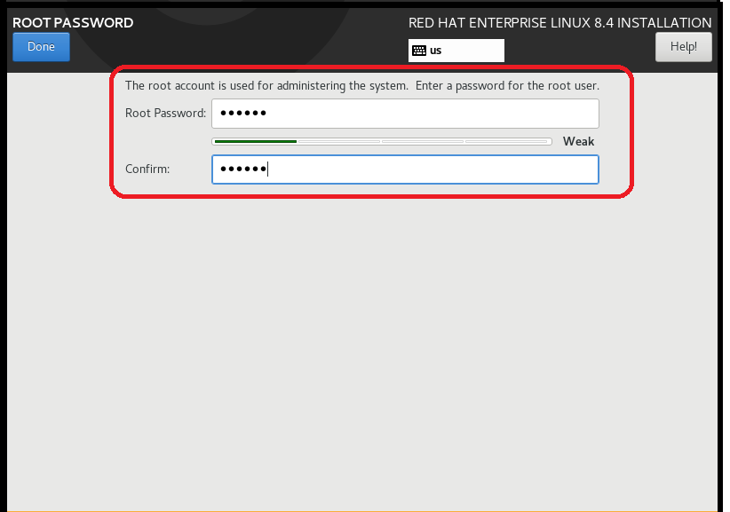
Set root password
  “redhat”
Click done

Slide 35
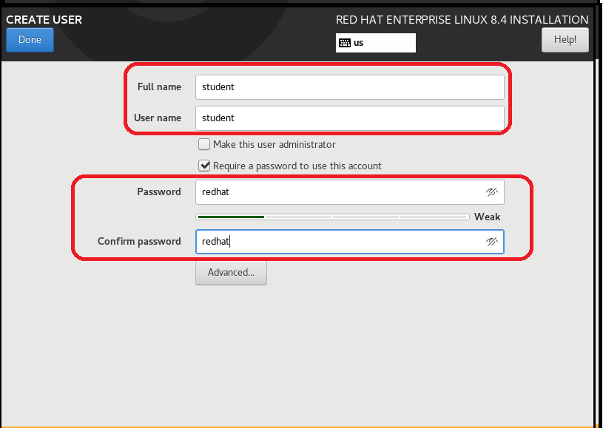
Create New user
  Username: student
  Password: redhat
Click done

Slide 36
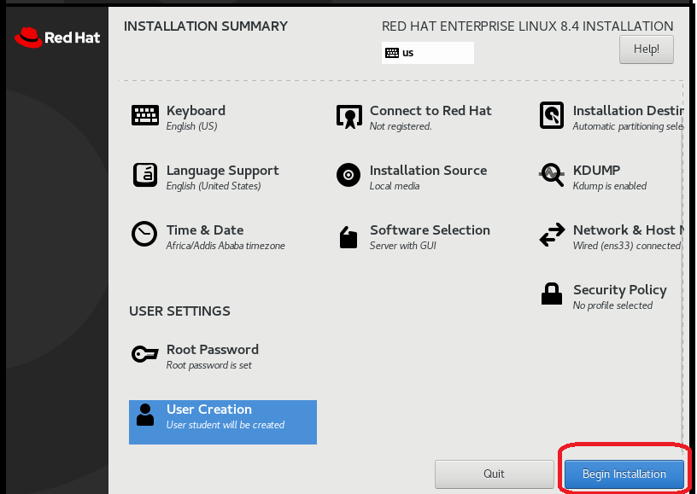
Begin installation

Slide 37
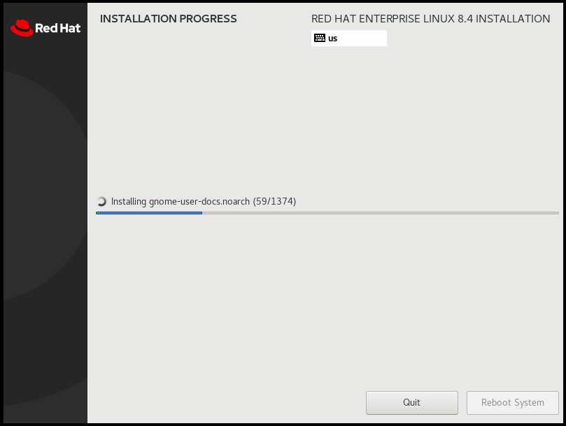
Watch installation progress
it may take a longer time depending on the Computer host performance

Slide 38
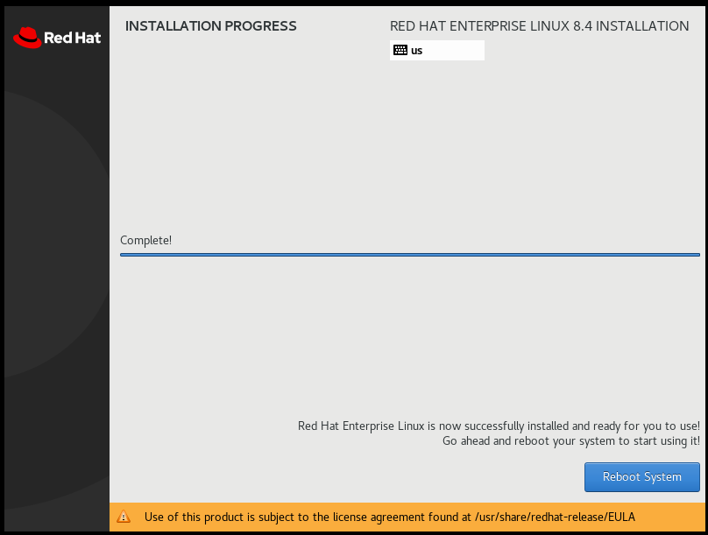
Click Reboot system

Slide 39
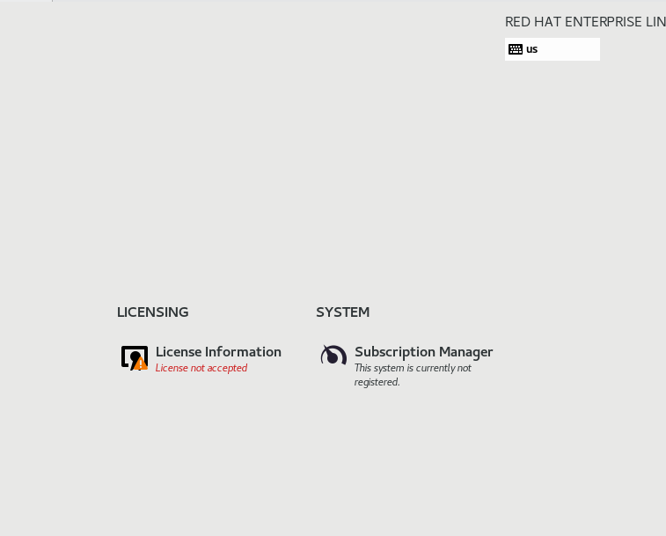
Click license information

Slide 40
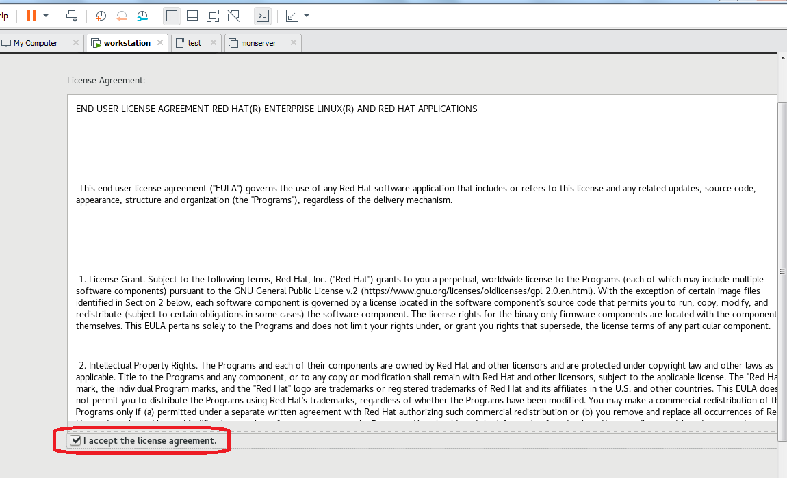

Slide 41
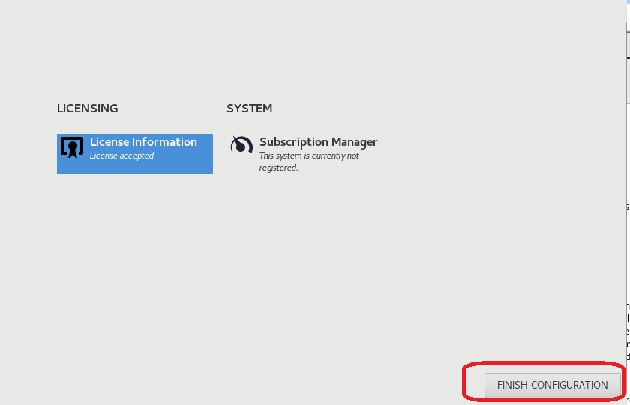

Slide 42
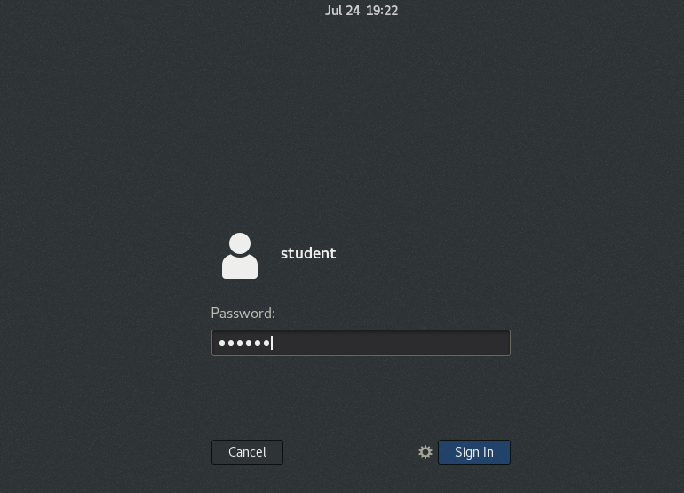
Click student user
Enter password: redhat
Click sign in

Slide 43
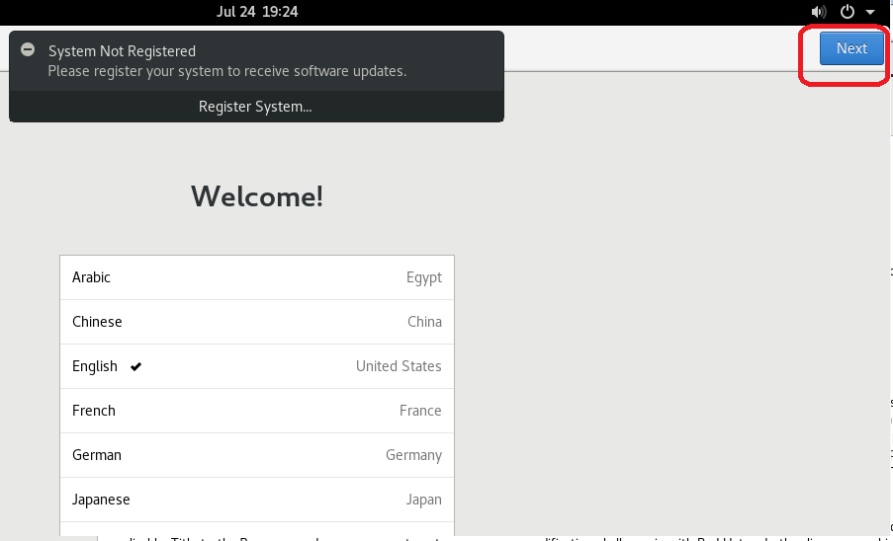

Slide 44
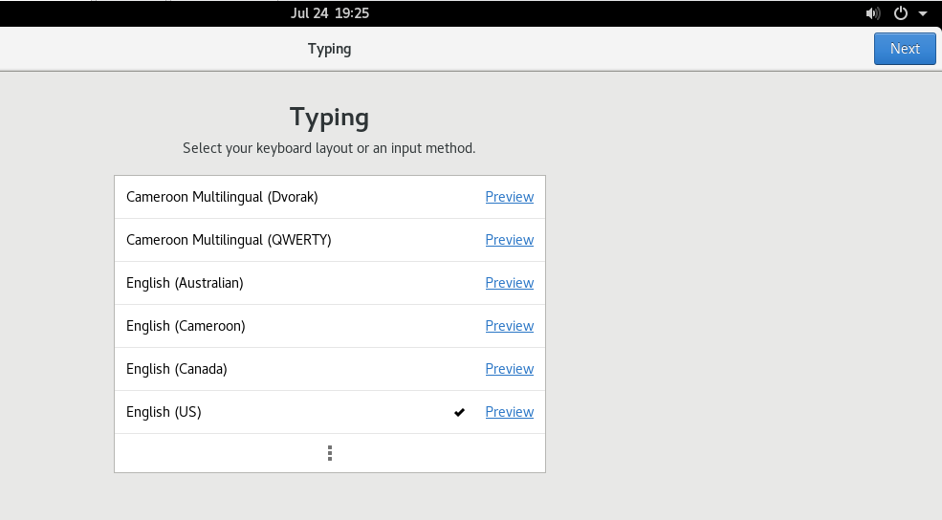

Slide 45
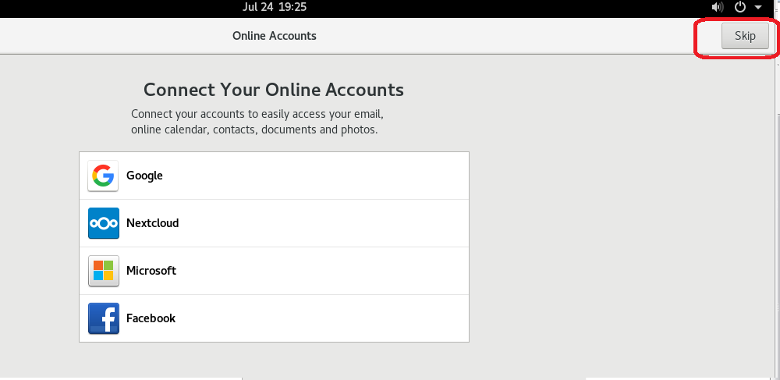
Click skip

Slide 46
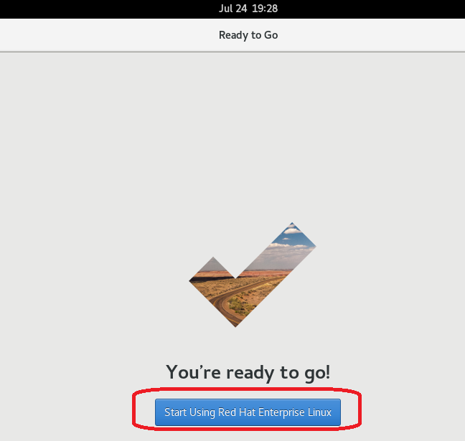

Slide 47
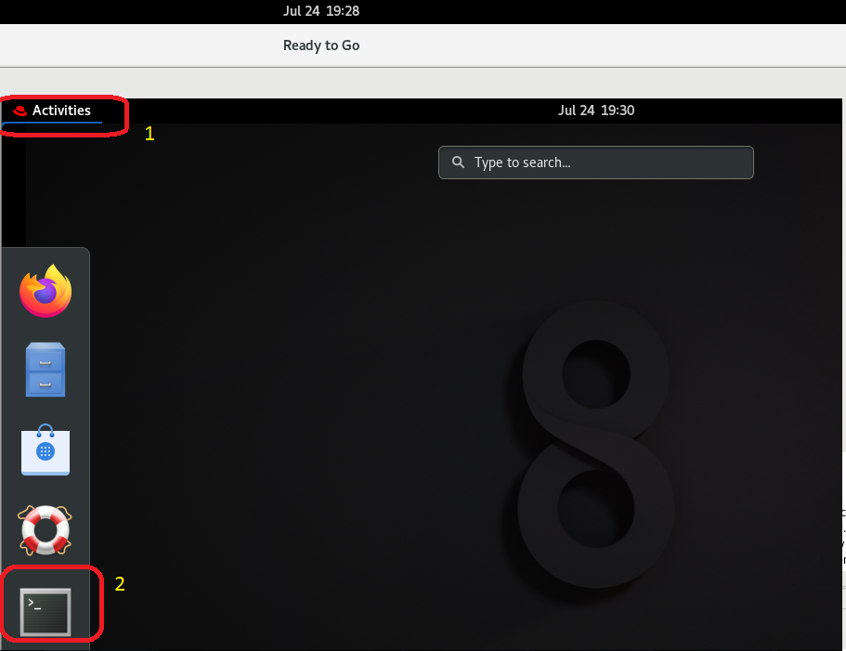
Open terminal

Slide 48
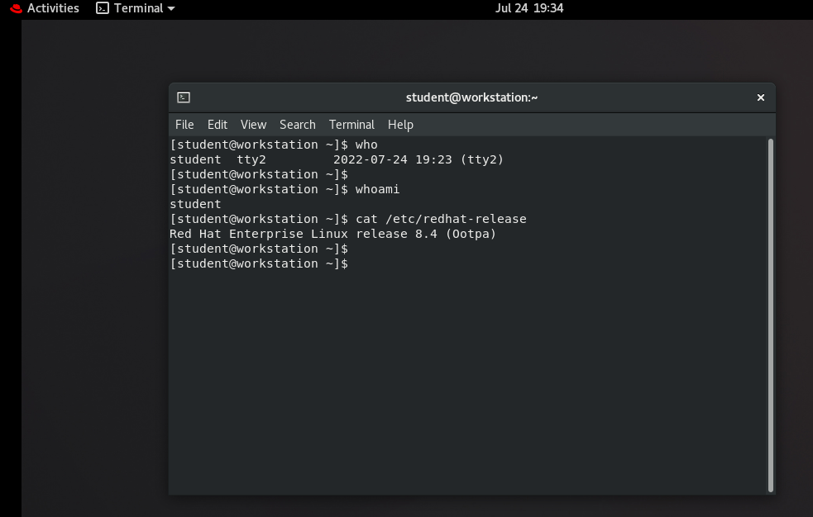

Slide 49
End of installation

